Slide 1
Yelp Analytics
Team 7
Chandni Sharma
Hari Panjwani
Sanath Shetty
INFO 7390 : Advances in Data sciences/Architectire

Slide 2
Problem Statement
Yelp provides researchers and students with real time data and challenges the users to make use of this data in an innovative way.
Using the dataset we have implemented
1. User Recommendation Service
2. Yelp Image Classification
3. Review Based Analysis

Slide 3
Yelp Recommendation
Content Based Filtering
Collaborative Filtering

Slide 4
Yelp Image Classification

Slide 5
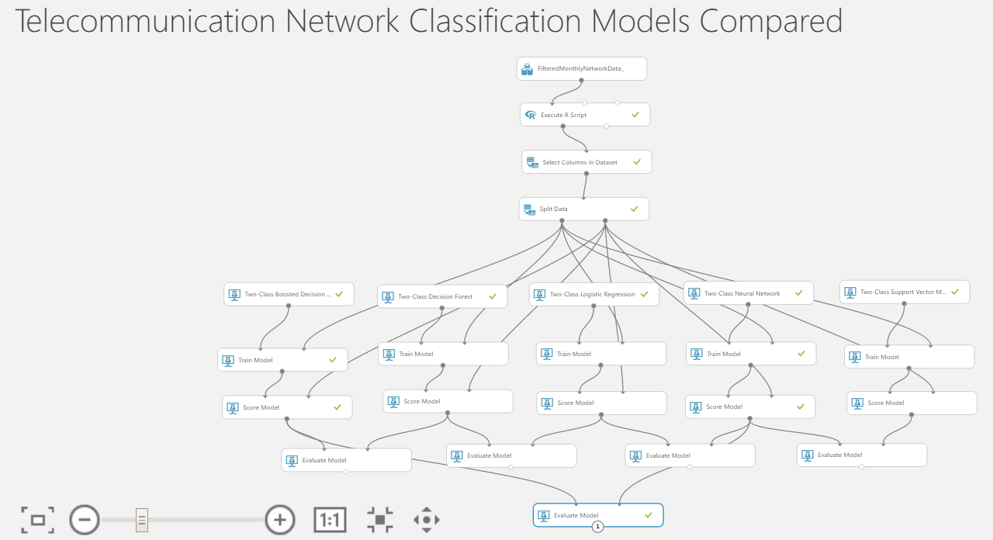

Slide 6
Classification Model | Mean Absolute Error, Root Mean Square Error, Relative Absolute Error Relative Squared Error | Coefficient of Determination
Boosted Decision Regression Tree | 0.24 0.37 0.39 0.23 | 0.27
Neural Network | 0.58 0.72 0.92 0.85 | 0.15
Bayesian Linear Regression | 0.58 0.73 0.92 0.86 | 0.13

Slide 7
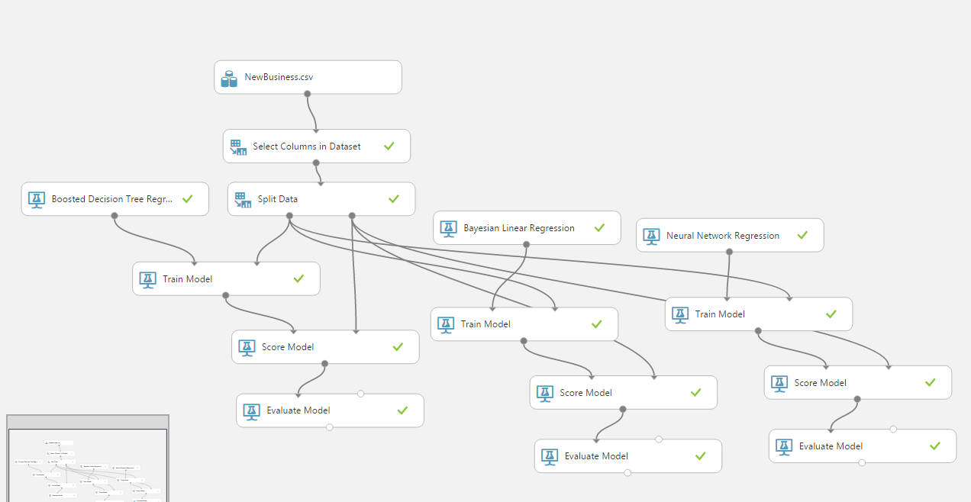

Slide 8
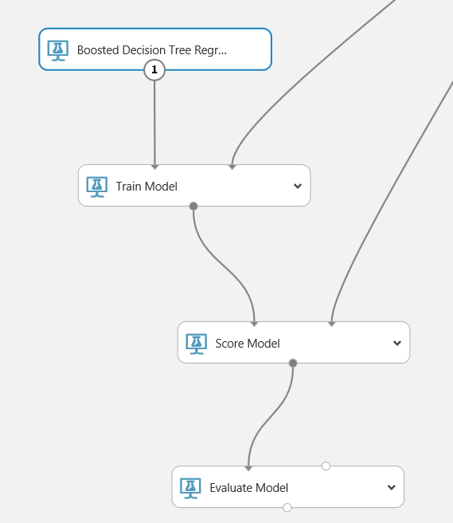

Slide 9
Yelp Review Based Analysis
Power BI

Slide 10
Thank You

